Slide 1
SALES INTELLIGENCE REPORT
Mobile & Device Sales
Dashboard Overview
Customer, Product & Region Performance Across Turkey, India, Pakistan & Bangladesh
Prepared from Mobile Sales, Product, Customer & Region Dashboards
September 2026

Slide 2
  MOBILE & DEVICE SALES PERFORMANCE
  Performance summary
Headline Performance Highlights
$14,525,413
18,548
$784
OnePlus
OnePlus
Nord4
Total Revenue
Units Sold
Avg Selling Price
Top Selling Brand
Top Selling Model
Insights & Impact
Online is the dominant channel, that generate the highest percentage of sales revenue (62%) well ahead of Retail Stores (25%) and Partners (12%).
OnePlus leads both brand and model rankings, highlighting strong market demand across the device lineup.
An average selling price of $784 alongside 18,548 units sold highlights premium smartphone segment.

Slide 3
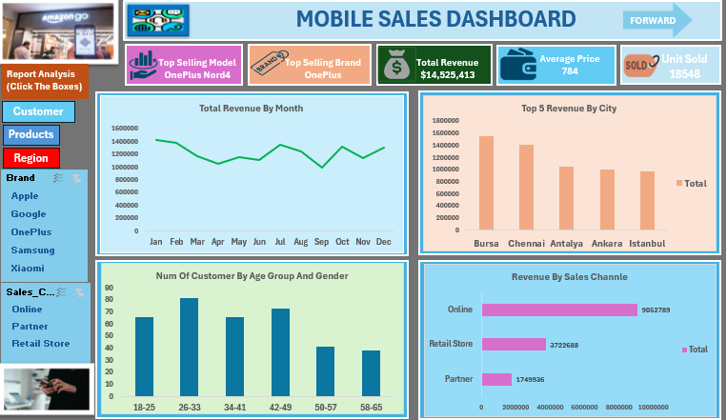
  MOBILE & DEVICE SALES PERFORMANCE
Dashboard 01. Mobile Sales
Monthly Trend, Top Cities & Customer Mix ( Age group & Gender)
Key Insights
A. Monthly revenue fluctuates, with a noticeable dip in September before increasing again in Q4 (October-December).
B. Bursa is the top revenue city, ahead of Chennai, Antalya, Ankara, and Istanbul in the top 5 breakdown, and it also leads in unit sales and customer count by city.
C. Customer aged 26–33 have the largest customer segment, followed closely by aged 42–49 age group.
D. Online sales drive the bulk of revenue at $9.05M, more than double retail stores $3.72M and over five times Partner sales $1.75M, online alone accounts for roughly 62% of total revenue.
E. OnePlus is the top selling brand overall, with the Nord4 as the best performing model, total revenue hit $14.5M on 18,548 units sold, at an average selling price of $784.

Slide 4
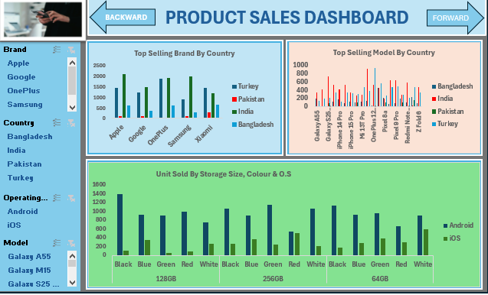
  MOBILE & DEVICE SALES PERFORMANCE
Dashboard 02 . Product Sales
  Brand & Model Performance by Country
Key Insights
A. India has the highest brand sales nearly every brand, followed by Turkey.
B. OnePlus and Samsung show the strongest cross-country demand among the five brand.
C. Android unit outsell IOS units across every storage (64GB,128GB & 256GB) and Green and Black are the top-selling color across all storage sizes.

Slide 5
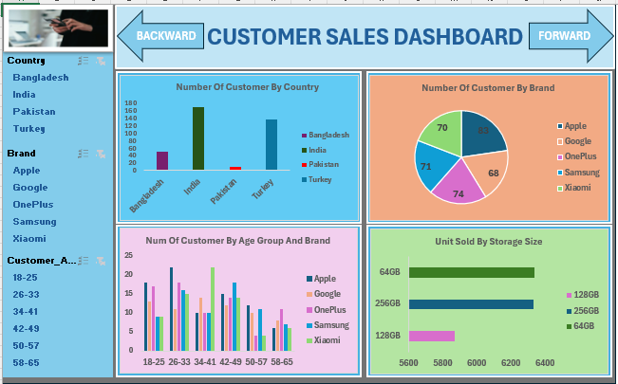
  MOBILE & DEVICE SALES PERFORMANCE
Dashboard 03. Customer Sales
Customer Trends And Preferences
A. India and Turkey have far more customer than Bangladesh and Pakistan. Pakistan contributes very few customers.
B. Customer count spread across brands, with OnePlus and Samsung, slightly ahead of Apple, Google and Xiaomi.
C. The Age group 26-33 and 34-41 are the most active buyers across nearly every brand. And OnePlus & Xiaomi popular among younger buyers.
D. 64GB is the top-selling storage size, followed by 256GB, while 128GB shows a preference for higher storage capacity.

Slide 6
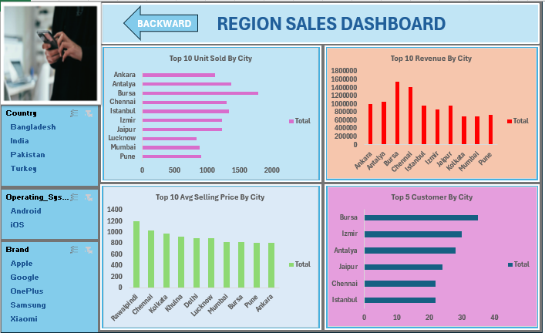
  MOBILE & DEVICE SALES PERFORMANCE
Dashboard 04. Region Sales
Region Sales Performance Overview
A. Bursa leads in unit sold, revenue, and top customer by city , despite not having the highest average selling price.
B. Rawalpindi has the highest average selling price, followed by Chennai and Kolkata, but it does not lead in unit sold and revenue.
C. Bursa and Izmir also top the list for customer count, showing that turkey cities are the strongest overall performers.

Slide 7
  MOBILE & DEVICE SALES PERFORMANCE
Summary
Recommendations
1. Mobile Sales
Online sales driving 62% of revenue. invest further in the online experience and customer retention offers rather than expanding physical retail.
2. Product sales
India & Turkey both markets lead in customers and unit sold. Prioritize investment in Localized marketing and inventory allocation to capitalize on demand across these two markets.
3. Customer sales
OnePlus leads both brand and model rankings. Strengthen this position through customer loyalty programs and timely launches of new models.
Region sales
High-price cities like Rawalpindi and Chennai differ from high-volume cities such as Bursa and Antalya. Tailor pricing and promotional strategies to each city demand and customer profile.

Slide 8
  MOBILE & DEVICE SALES PERFORMANCE
Conclusion
Overall, sales performance is strong, driven mainly by online sales, which contribute about 62% of total revenue. India and Turkey are the strongest markets, with Bursa leading in revenue, unit sales, and customer volume. OnePlus remains the top-performing brand, led by the Nord4 model, while customers aged 26–33 have the largest customer segment. The findings highlight opportunities to strengthen online sales, focus on high-performing markets, and tailor pricing and product strategies to local customer preferences.
$14.53M
Revenue
18,548
Unit Sold
62%
Online Share

